Slide 1
Anatomy
Myology
By: Dr. Ammar Ismail

Slide 2
Myology:(Muscular system)
Branch from the anatomy which study muscles and accessory structure such as fascia, synovial sheath.
Muscles: The contractile organs responsible for movement in an animals.

Slide 3
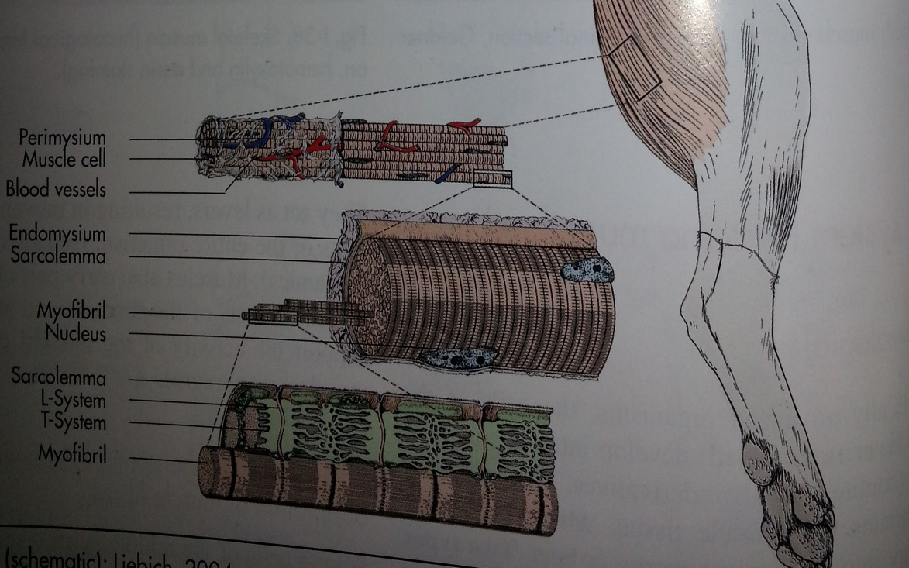
Classification of the muscles:
A-according to the morphology of the muscle:
Striated (skeletal, cardiac)
Un striated ( smooth) GIT
B- according to the function:
Voluntary muscles. Skeletal muscles, they allow movement from one place to another, generally attached to bone.

Slide 4
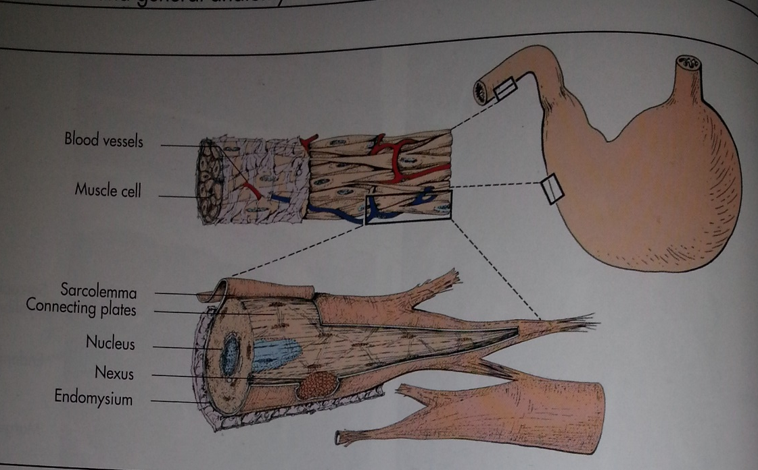
Classification of the muscles:
Involuntary muscles. Cardiac and smooth muscles are responsible for breathing, heart beat, peristaltic movements of intestine, constriction of blood vessels

Slide 5
Skeletal muscles
The skeletal muscles are voluntary and consisted of three general parts: The contractile muscle belly and two ends, covered by sheath epimysium. This ends is called tendons or aponeurosis connect with any bone or cartilage or muscles.
Note: Skeletal muscle will not contract in the absence of a functional nerve supply (denervation atrophy occurs). One neuron innervates a variable number of muscle fibers.
The neuron plus the muscle fibers it innervates constitute a motor unit.
To produce a stronger contraction, the nervous system activates more motor units.

Slide 6
Muscle-related connective tissue:
Muscle associated fascia:
1. epimysium = loose or dense connective tissue surrounding an entire muscle
2. perimysium = loose or dense connective tissue defining muscle fascicles
3. endomysium = small amounts of loose c.t. surrounding individual muscle fibers

Slide 7
The are two types of attachment of skeletal muscles with skeleton :
1- Fleshy attachment smooth
2- Tendonous attachment

Slide 8
Tendon protection:
A. bursa = synovial pocket inserted between a tendon and a bony prominence
B. tendon synovial sheath = lubrication where tendons are bound, e.g., by retinaculum

Slide 9
Muscle names:
Muscle names may be latinized (flexor digitorum profundus) or anglicized (deep digital flexor). Muscle are named (originally in the human) for their shape (deltoideus) or location (brachialis) or attachments (sternohyoideus) or structure (biceps) or function (sphinactor) or combinations of these (pronator quadratus; superficial digital flexor; serratus ventralis; flexor carpi radialis; etc.)

Slide 10
Shape of skeletal muscle:
Muscle can be classified according to the morphology into:
1- strap muscle(wide m.): the bundle of myofibril is parallel.
a- Wide muscle imbued with tendinous.
b- Wide muscle with aponeurosis.
2- Fusiform muscle( spindle m.): this type contain one tendon or more than.
a- single headed muscle
b- two headed muscle (biceps muscle)
c- three headed muscle (triceps muscle)
d- four headed muscle (quadriceps muscle)
3- Digastric muscle (two bellied m.): when the muscle contain two gastric.
4- pennate muscle ( unipennate, dipennate, multipennate)
5-Circular muscle (orbicularis m.)
6- Sphincter muscle (sphincter m.)

Slide 11
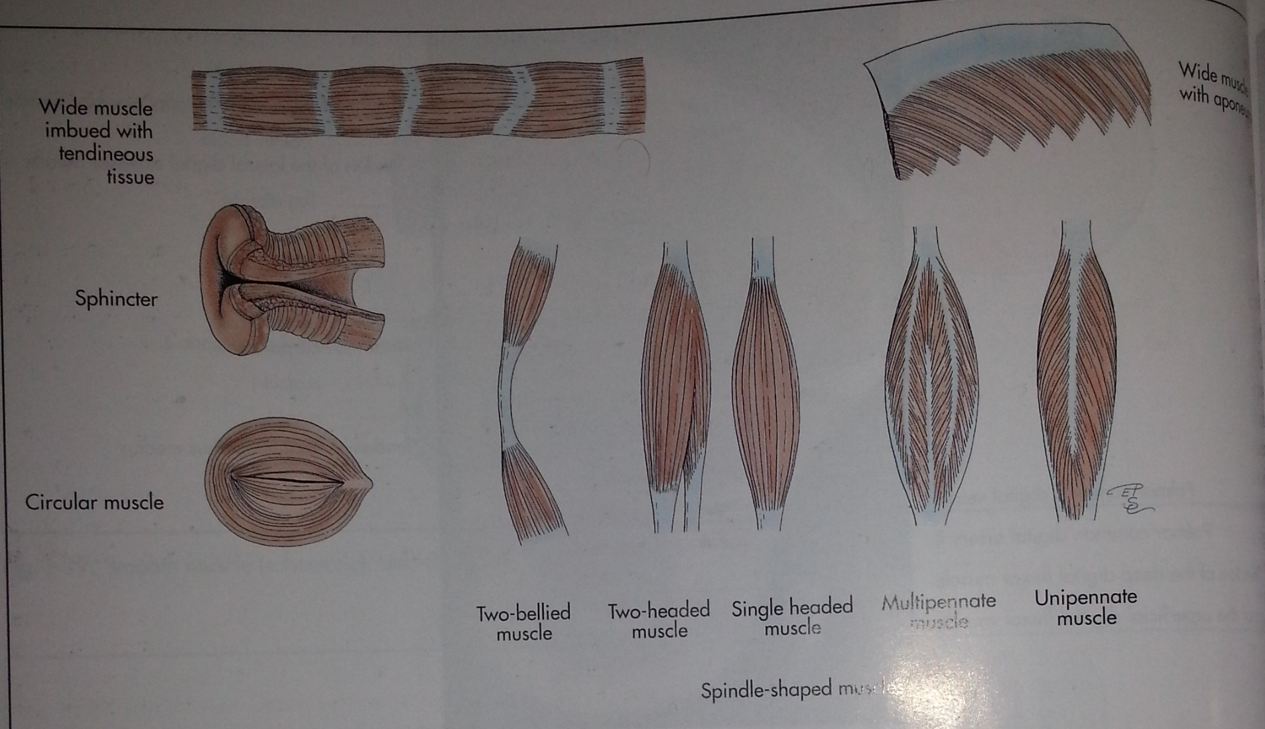

Slide 12
Muscle can be classified according to the function or effect into:
1- extensor:
2- flexor
3- adductor
4- abductor
5- sphincter
6-dilator
7- levator
8- depressor
9-rotator
10- supinator
11-pronator

